Slide 1

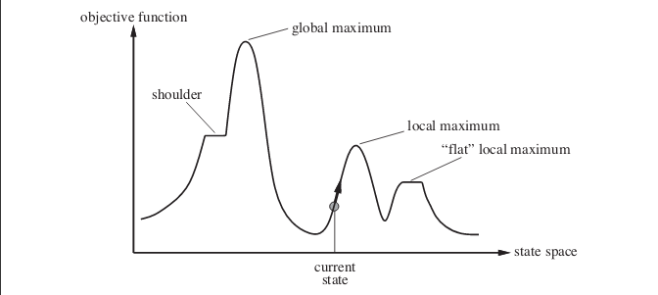
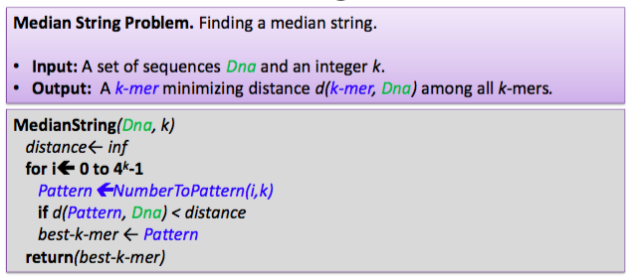
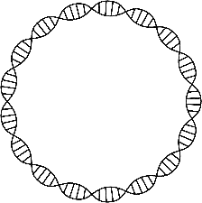



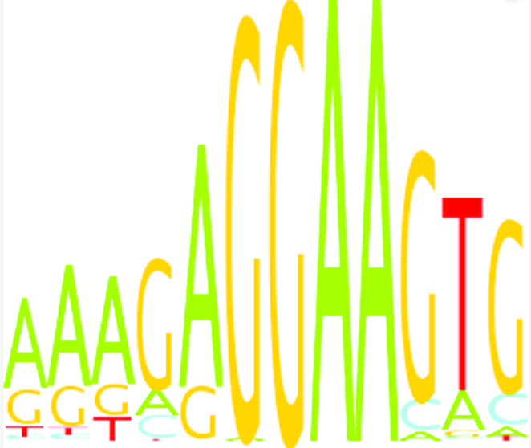
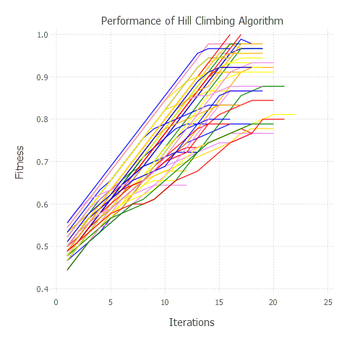
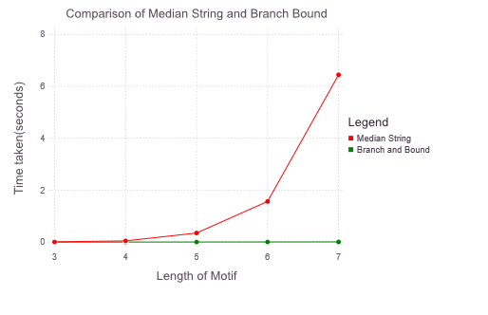
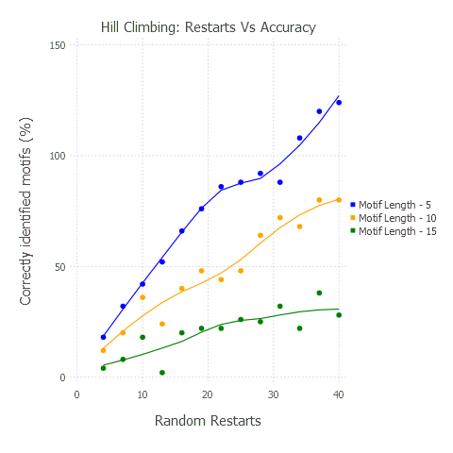
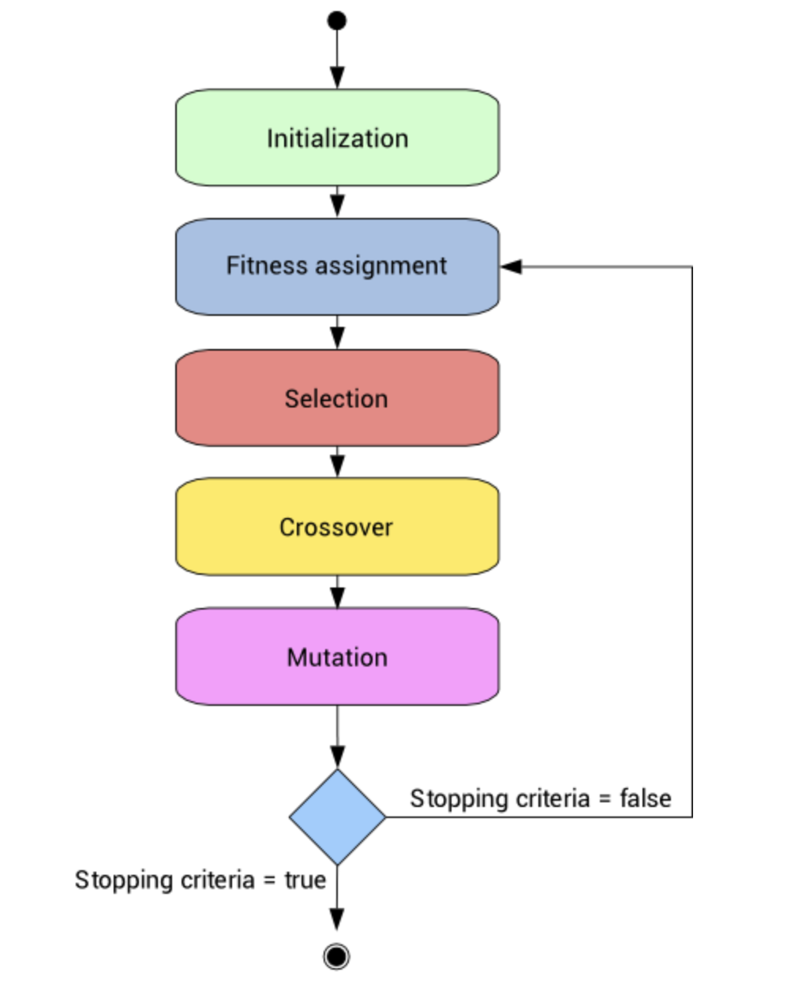
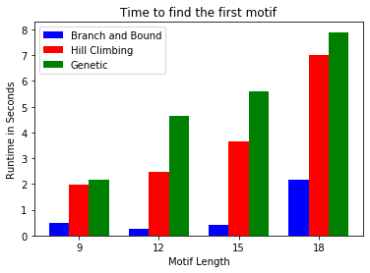
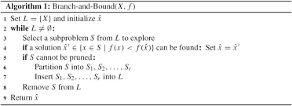
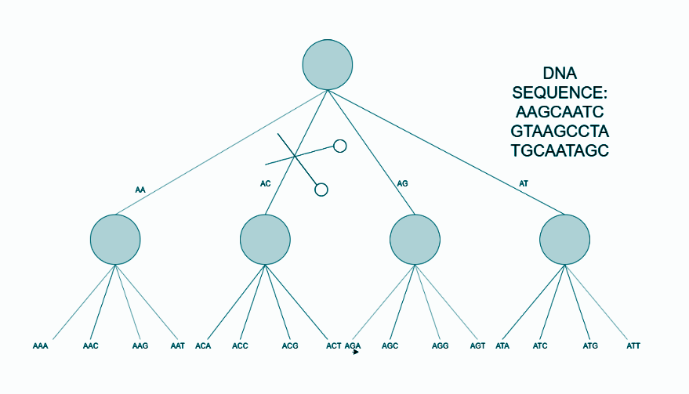
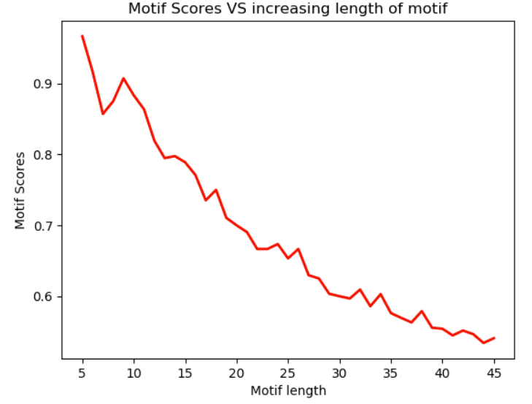
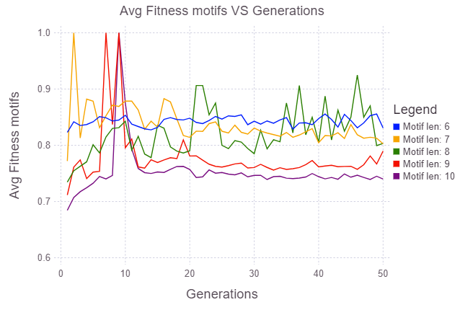
Analysis of Motif Discovery Algorithms
HILL CLIMBING
MEDIAN STRING
Discrete Space Hill Climbing Algorithm
currentNode = startNode;
loop do
L = NEIGHBORS(currentNode);
nextEval = -INF;
nextNode = NULL;
for all x in L
if (EVAL(x) > nextEval)
nextNode = x;
nextEval = EVAL(x);
if nextEval <= EVAL(currentNode)
//Return current node since no better neighbors exist
return currentNode;
currentNode = nextNode;
Algorithms | Exhaustive | Heuristic | Meta-Heuristic
Can deal with a big data set
Is it fast?
Can it find long motif?
Is it a global search?
Low number of required parameters
Representation | Consensus | PWM | Flexible
Can it find all motifs?
Can it find weak motifs?
Degenerate positions | Limited | Flexible | Flexible
Objective function | Flexible | Flexible | Flexible
Is it a simple concept?
Derivation-free mechanism
The graph shows the runtime behaviour of the hill climbing algorithm. This is a heuristic algorithm, and the graph shows how the fitness score of the motif increases as the iteration progresses. Different colors depict different random restarts for the same experimental run.
Consensus String: Median String Motif discovery algorithm attempts to find the consensus string. Consensus Motif represent the motif as a single sequence where only one base/amino acid is allowed in a certain position
Runtime of Median String Search is exponential in nature as show in the graph. This exhaustive search can be improved by using branch and bound algorithms, which shows a linear trend as opposed to brute force algorithms exponential time complexity.
GENETIC ALGORITHM
A genetic algorithm is a metaheuristic inspired by the process of natural selection.
Initialization: | Randomly chosen motifs.
Fitness Assignment | Hamming Distance of motifs.
Selection: | Choose the top motifs having the highest score.
Crossover: | Creating motifs from two parent motifs
Mutation: | Randomly change one character in the motif.
Stopping Criteria: | Hamming Distance = zero or time threshold
The graph shows the impact of random restarts in improving the overall accuracy of the hill climbing algorithm.
BRANCH AND BOUND MEDIAN SEARCH
Branch and Bound is an algorithmic paradigm in which certain nodes and its children are not searched, as the existing path fails to satisfy the
threshold condition of search.
In the case of Median search, Branch and bound ignores search spaces where an existing prefix is not frequent.
Genetic algorithms are meta heuristic in nature. As the length of motif increases, it shows the deterioration of the overall fitness scores achieved for fixed iteration and time values.
Trend of fitness with respect to increasing generations, for different motif lengths.
The initial spikes show that the motif can be found at any generation. It requires more generations for high length motifs to be found

Slide 2

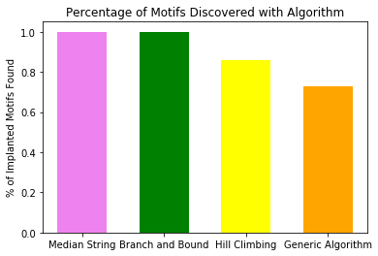
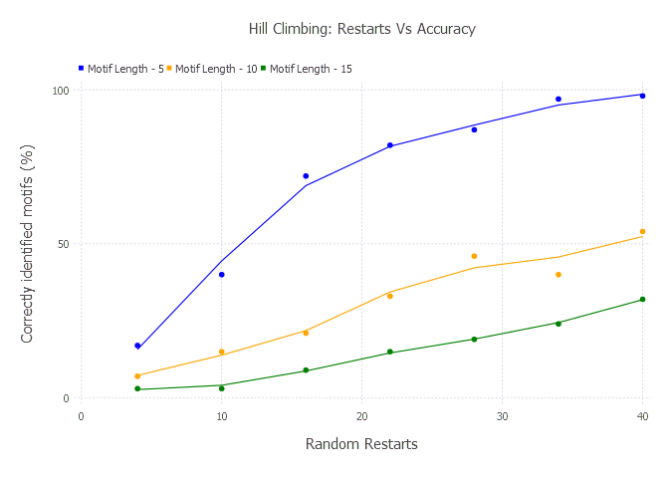
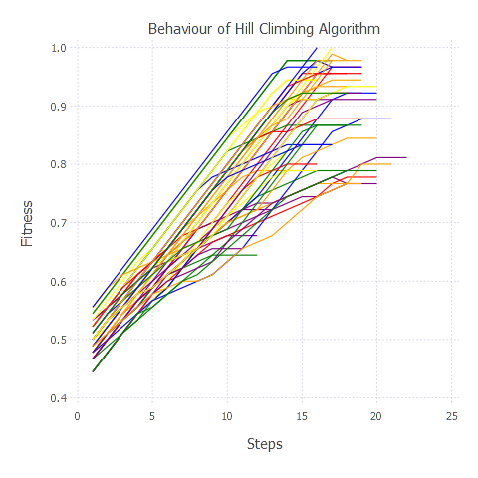
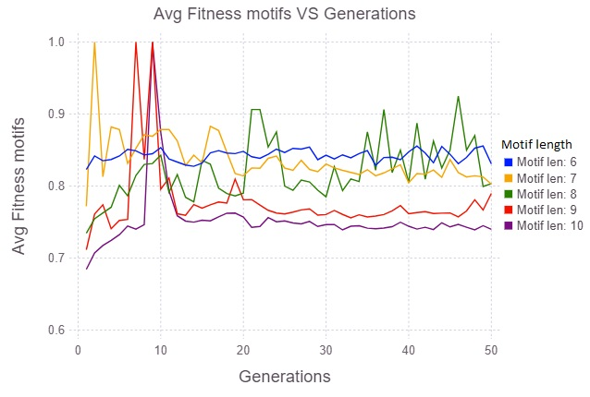
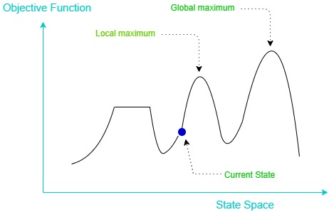
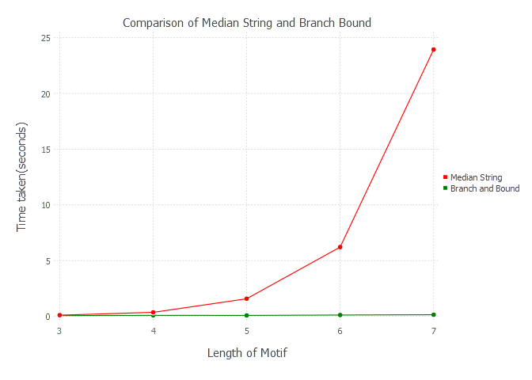
Analysis of Motif Discovery Algorithms
Team members:
Akaash Hazarika
Poovanna Kuttetira
Abhishek Pareek
GOAL
GENETIC ALGORITHM
RESULTS
Implement the following Motif discovery algorithms in Julia:
Median String Motif Search
Branch-and-Bound Motif Search
Hill Climbing
Genetic Algorithm
Validate and verify the correctness of the implementations.
Analyze performance for runtime behavior with respect to varying input parameters.
A genetic algorithm is a metaheuristic inspired by the process of natural selection.
Initialization | Randomly chosen motifs.
Fitness Score | Hamming Distance of motifs.
Selection | Choose the top motifs with the highest score.
Crossover | Create motifs from two parent motifs
Mutation | Randomly change one character in the motif.
Stopping Criteria | Hamming Distance = zero or time threshold
Measure of correctness of algorithms( Artificial DNA data )
Initialization
Fitness Assignment
The experiment was run on Athialana Geneme. The dataset is as follows.
Sequence Length: 2000
No. of DNA sequences: 4
Motif length: 6
No of Motifs: 166
Iterations Considered: No of Motifs*5
Online Tool:: Meme Suite
Selection
Crossover
DATASETS
Mutation
Artificial DNA synthesizer
Implemented artificial DNA synthesizer with the ability to vary GC content and implant motifs at arbitrary positions.
Real world dataset
A.thaliana genome sequence (subset)
The graph shows the impact of random restarts in improving the overall accuracy of the hill climbing algorithm. The experiment was performed on dna sequence length of 200 with 10 implanted motifs of the given length.The average of 10 runs was taken for each data point in the graph.
Stopping criteria = true
Stopping criteria = false
EVALUATION METRICS
Correctness: Whether the algorithm is able to identify the implanted Motifs.
Time taken to find the first Motif.
Time taken to find all the Motifs.
Correctly identified Motif (%) vs Number of restarts ( heuristic algoritms )
Average fitness score vs Generation for heuristic algorithms.
Analyzing Heuristic and Meta-heuristic algorithms
METHODS
The graph shows the runtime behavior of the hill-climbing algorithm. The hill-climbing algorithm was run for a DNA sequence of length 400 with 10 implanted motifs of length 30. Each line in the graph corresponds to one of the 50 random restarts. The graph shows how the fitness score of the motif increases as the iteration progresses. Different colors depict different random restarts for the same experimental run.
MEDIAN STRING SEARCH
MedianString( DNA, k )
distance = inf
for i = 0 to 4^{k}-1
Pattern = NumberToPattern(i,k)
if d( Pattern, DNA ) < distance
best-k-mer = Pattern
return best-k-mer
The Median String algorithm is a brute force technique that attempts to find the consensus motif of a particular length. The consensus motif represents the motif as a single sequence where only one base/amino acid is allowed in a certain position.
Algorithms | Exhaustive | Heuristic | Meta-Heuristic
Can deal with a big data set
Is it fast?
Can it find long motif?
Is it a global search?
Can it find all motifs?
Can it find weak motifs?
Genetic Algorithm: Trend of fitness for increasing generations, for different motif lengths. As the length of the motif increases, the number of generations required to discover the motifs also increases. The initial spikes in the graph show that the motif can be discovered at any generation.
BRANCH & BOUND
Set L = { X } and initialize x
While L != Ø:
Select a subproblem S from L to explore
If a solution X̂ ε { x ε S | f(x) < f(X̂) } can be found:
Set X̂ = (X̂)^t
If the subproblem S cannot be pruned:
Partition S into S1, S2… Sn
Insert S1, S2.. Sn into L
Remove S from L
Return X̂
CONCLUSION
Exhaustive algorithms, though accurate for small input sizes, come with overwhelming drawbacks and are computationally infeasible for real-world data sets.
Heuristic and Meta-Heuristic algorithms are reasonable choices for real-world datasets and overcome many of these drawbacks, albeit with the tradeoff of degraded results.
Time taken to find first Motif
In this experiment, we considered three artificial DNA strands of length 130 each, with four implanted motifs of various lengths. The time it took to find the first motif was recorded. In the case of heuristic algorithms, the results are the average of 10 different runs.
HILL CLIMBING
REFERENCES
Hill-Climbing-Algorithm()
currentNode = startNode
loop do
L = NEIGHBORS(currentNode);
nextEval = -INF;
nextNode = NULL;
for all x in L
if (EVAL(x) > nextEval)
nextNode = x;
nextEval = EVAL(x);
if nextEval <= EVAL(currentNode)
//Return current node since no better neighbors exist
Return currentNode;
currentNode = nextNode;
A Comparative Analysis of Motif Discovery Algorithms http://article.sciencepublishinggroup.com/html/10.11648.j.cbb.20160401.11.html
A survey of DNA motif finding algorithms
https://bmcbioinformatics.biomedcentral.com/articles/10.1186/1471-2105-8-S7-S21
https://bmcbioinformatics.biomedcentral.com/articles/10.1186/1471-2105-5-170
Runtime performance of Median String and Branch & Bound
The runtime of the Median String Search is exponential in nature, as the graph shows. This exhaustive search can be improved by using branch and bound techniques, which shows a subdued trend as opposed to the brute force algorithm's exponential time complexity.

